Slide 1

Waterfall vs. agile software development
Jay Liang

Slide 2
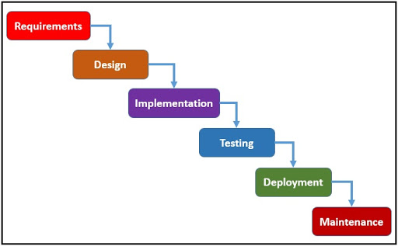
Waterfall Software Development
Sequential design process
Each phase is started and completed before moving on to the next
Once a phase is completed developers can not go back to a previous one

Slide 3
Phases
Requirements - concept or idea
Design – Logical design and Physical design
Implementation – Turning your design into software
Testing – testing for flaws or errors
Deployment – releasing the product into the market
Maintenance – modifications

Slide 4
Advantages and Disadvantages of Waterfall Software Development
Advantages
Disadvantages
Easy to understand
Easy to manage
Fewer production issues
Better budget management
Not flexible
Cannot handle unexpected risks well
Not a good model for complex or long-term projects

Slide 5
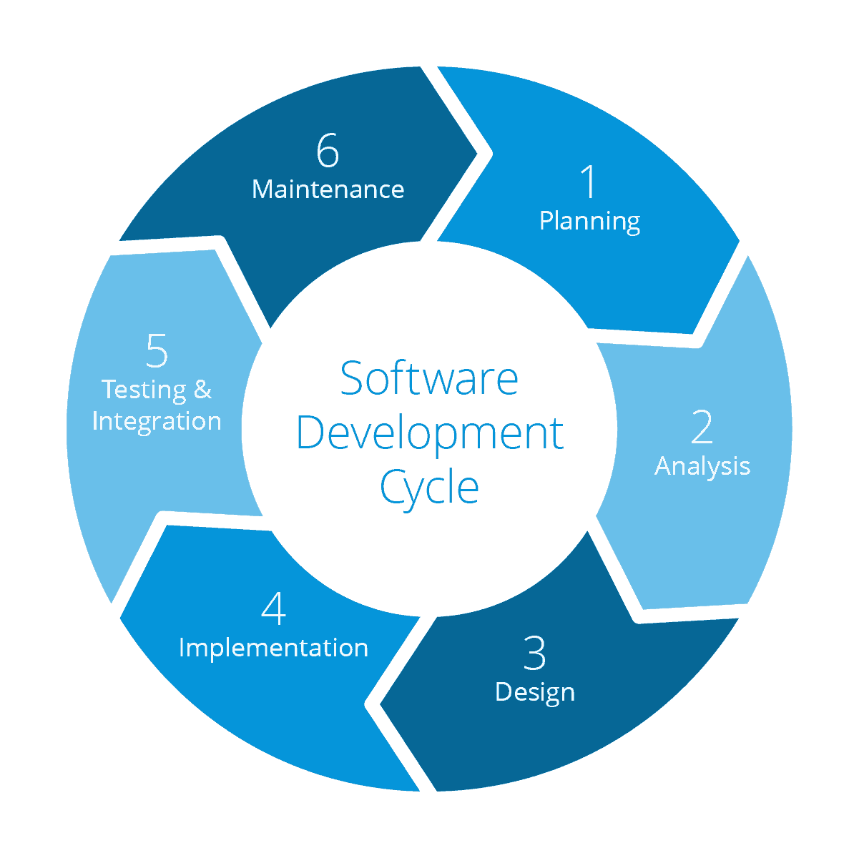
Agile Software Development
Incremental Process
Starts out with a simplistic product design
Allows for modification
Was created as a solution to the downsides of waterfall

Slide 6
Advantages and Disadvantages of Agile Software Development
Advantages
Disadvantages
Flexible
Higher Customer Satisfaction
Higher Product Quality
Can handle unexcepted changes
Hard to budget properly
Harder to manage

Slide 7
Conclusion
Agile
Waterfall
No clear picture of the final product
Flexible
Very clear picture of the final product
Documented

